Slide 1
TEXTILE PROJECT
Team:
Jan Tautorus
Sezgi Yalçınkaya
Jing Li
Doreen Steven Mlote

Slide 2


MFA
TEXTILE LIFE CYCLE - SIMPLIFIED
LCA
Reuse
INCINERATION
PLANT
WASTE
Sale
Discard
RAW MATERIALS
PRODUCTION
STORE
CONSUMER
SORT
Probabilistic Lifetime of Products
RECYCLE
RECYCLED MATERIALS

Slide 3
Product Categories & Types
Clothing type
t-shirts
trousers
overcoats
underwear
handkerchiefs_1
shirts_1
sportswear
handkerchiefs_2
shirts_2
sweaters
Category | Fibre 1 | Fibre 1 % Range | Fibre 2 | Fibre 2 % Range | Fibre 3 | Fibre 3 % Range
Shirts, Blouses, Tops | Polyester | 41-50% | Wool | 41-50% | NA | NA
Shirts, Blouses, Tops | Polyester | 91-100% | NA | NA | NA | NA
Shirts, Blouses, Tops | Acrylic | 81-90% | Polyester | 10-20% | Elastane/Spandex | <10%
Shirts, Blouses, Tops | Polyester | 61-70% | Viscose | 31-40% | NA | NA
Shirts, Blouses, Tops | True Hemp | 51-60% | Polyester | 21-30% | Cotton | 10-20%
Shirts, Blouses, Tops | Wool | 41-50% | Cotton | 41-50% | Polyamide/nylon | <10%
Shirts, Blouses, Tops | Polyamide/nylon | 41-50% | Animal hair (alpaca, llama, camel, kashmir goat, angora goat, angora rabbit) | 21-30% | Wool | 10-20%
Shirt 1
Shirt 2

Slide 4
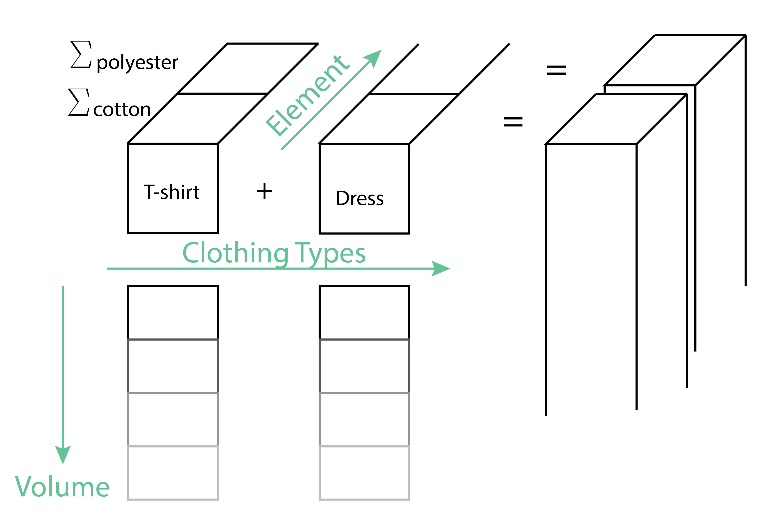
MFA DIMENSIONS

Slide 5
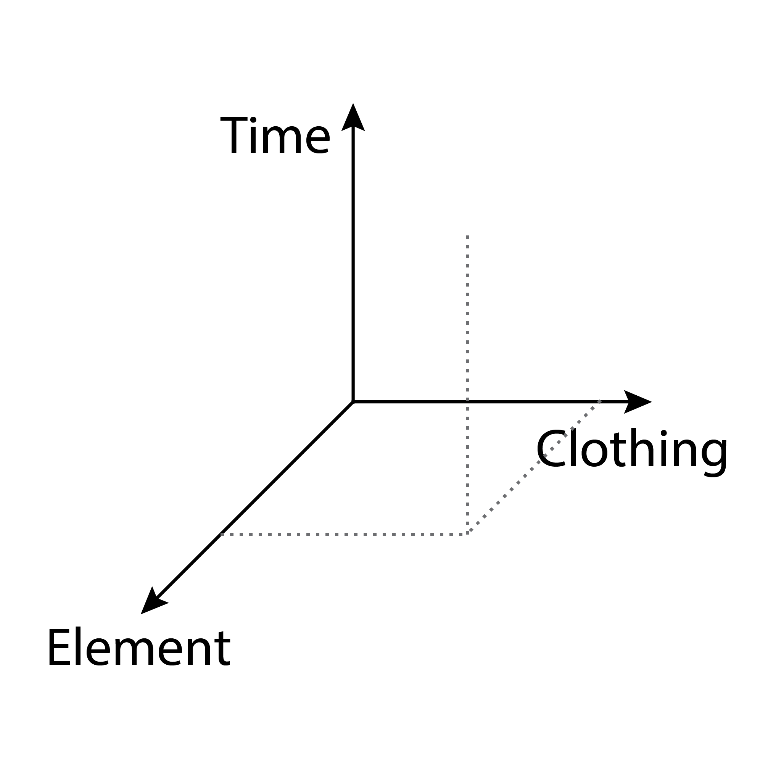
INDICES
Aspect | Description | Dimension | Index Letter
Time | Model aspect "time" | Time | t
Age_Cohort | Model aspect "age cohort" | Time | a
Element | Model aspect "fiber type" | Element | e
Clothing | Model aspect "clothing type" | Clothing | c

Slide 6
MFA
LCA
F₃₋₁
Reuse
(t, e, c)
INCINERATION
PLANT
WASTE
0
Sale
Discard
3
F₃₋₀
RAW MATERIALS
CONSUMER
PRODUCTION
STORE
F₁₋₂
S₂, S₂
F₂₋₃
SORT
(t, e)
F₀₋₁
1
F₃₋₄
(t, e, c)
2
(t, e, c)
(t, e)
(t, e, c)
(t, a, e, c)
RECYCLE
RECYCLED MATERIALS
Probabilistic Lifetime of Products
4
F₄₋₀
(t, e)

Slide 7
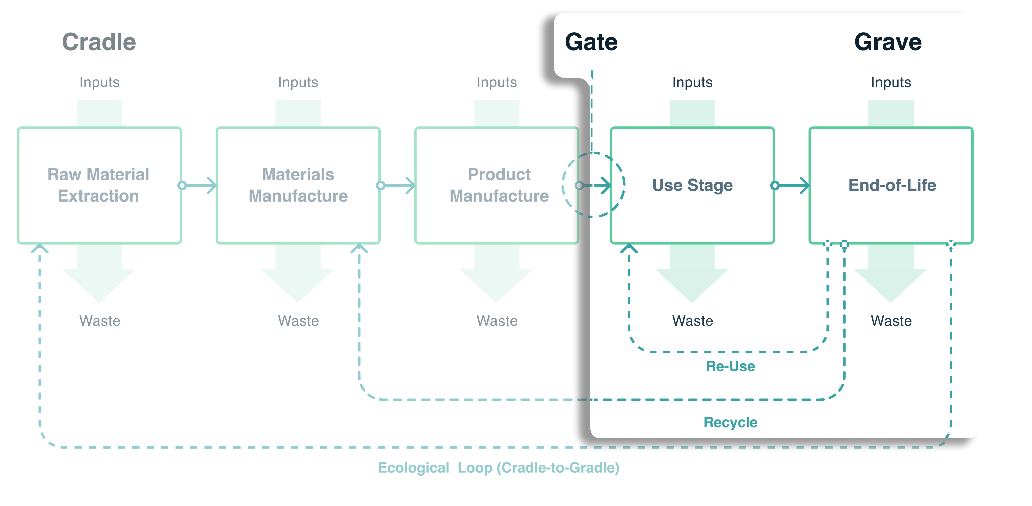
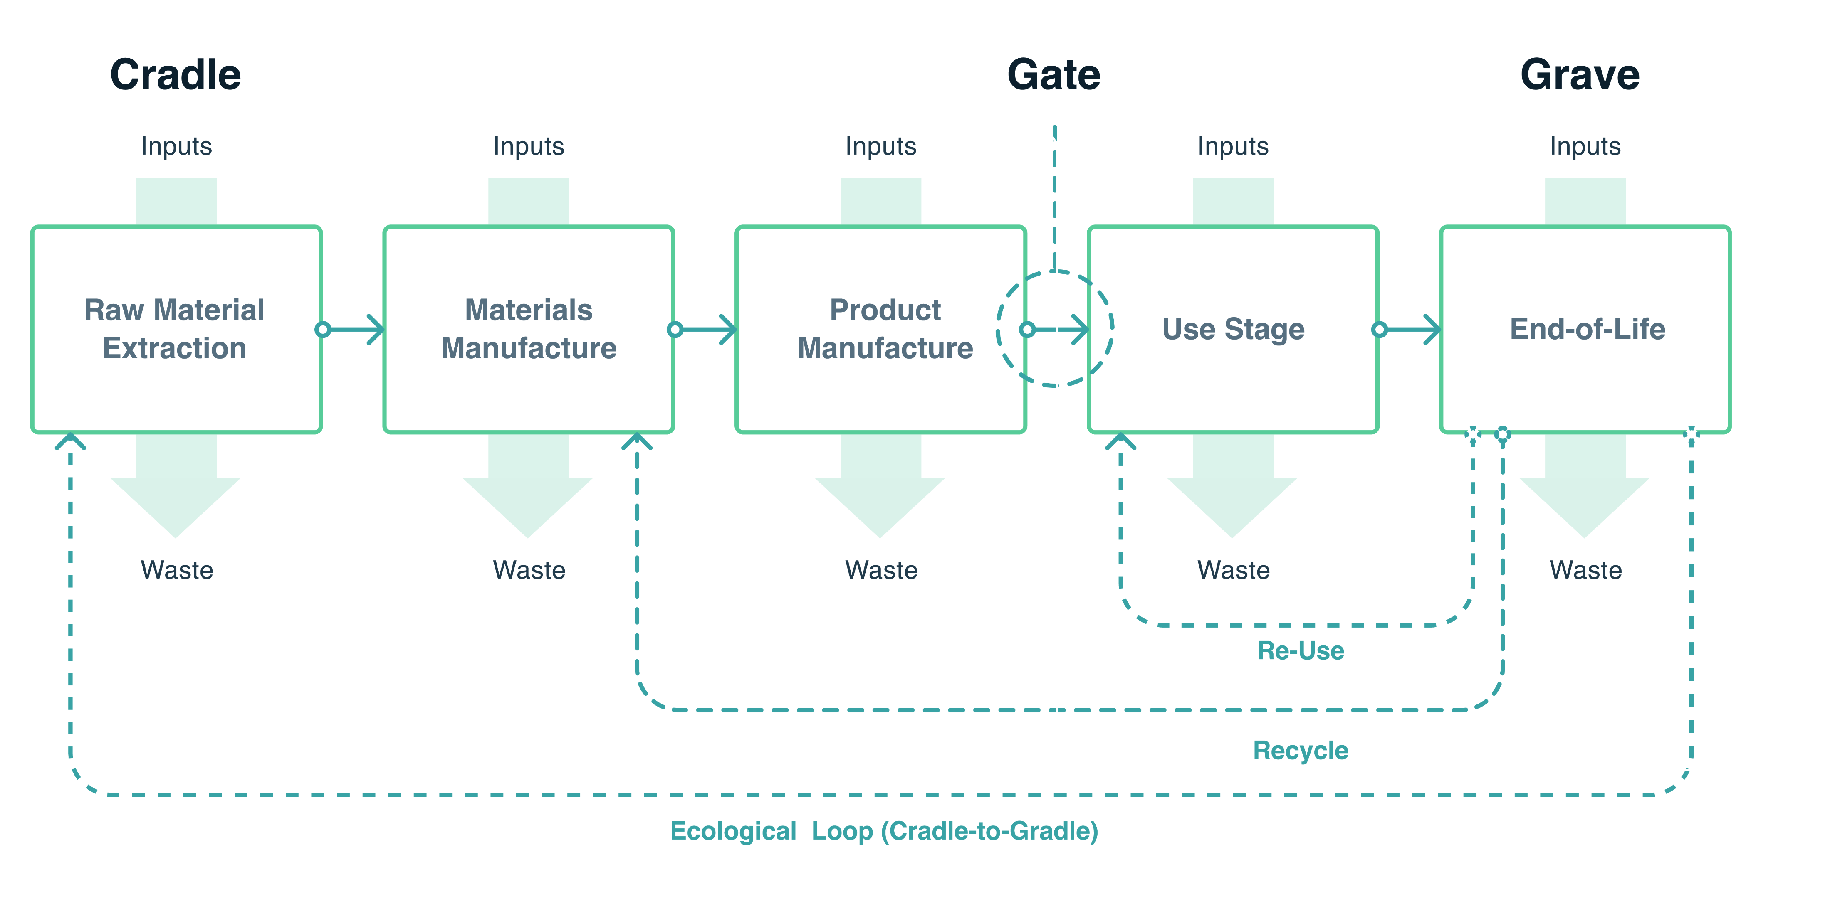
LCA STAGES
Source: www.paintsforlife.eu/

Slide 8
LCA STAGES - SCOPE
Source: www.paintsforlife.eu/

Slide 9
STRUCTURE - DEMO
BUILD THE MODEL:
Preprocess Excel Data -> Average clothing per group,
MFA Model and equations + solve equations (maybe parametrize model)
ODYM Model setup and data import
ETL pipeline from ODYM to Brightway + Connect flows with Ecoinvent (or other database)
Brightway processing
LCI of composition materials + incineration process
RUN THE MODEL:
Create Scenarios
Run the model to exercise scenarios
Interpret results
SCENARIO PROPOSALS:
Changing Lifetimes, eg Durable T-shirts
Dramatic fashion trend changes
Recycling Technology improves, i.e the share of recycling becomes > waste

Slide 10
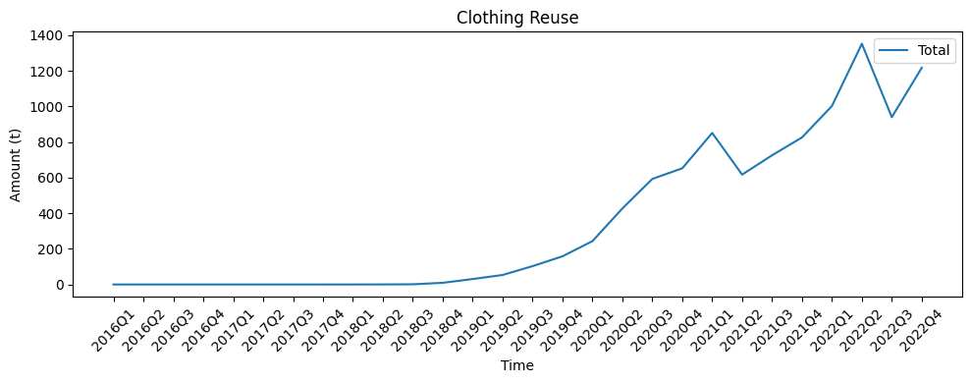
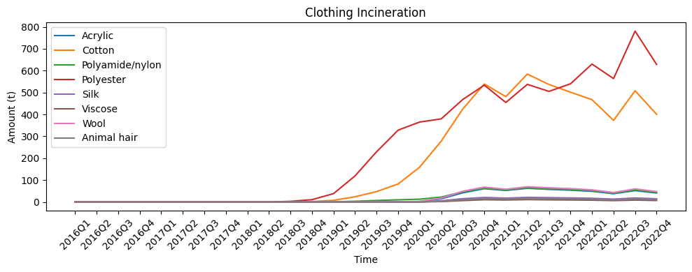
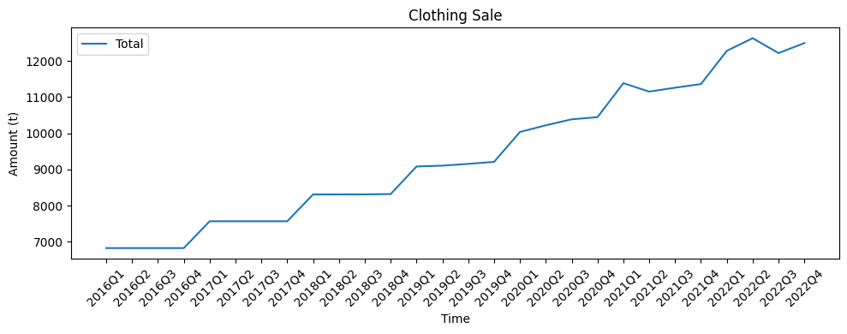
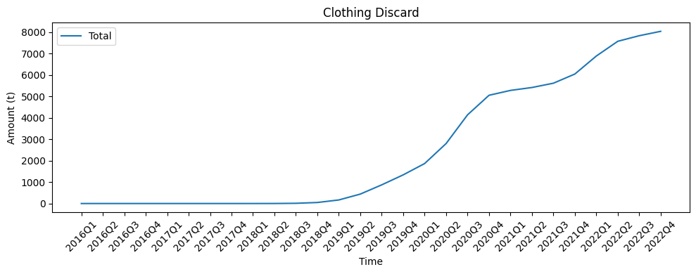
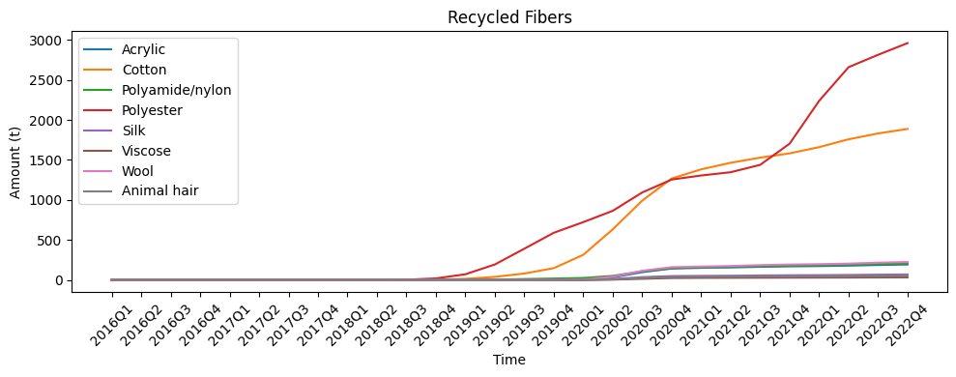
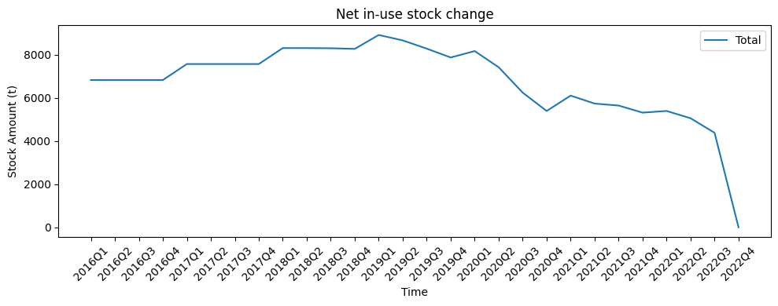
MFA
VISUALIZATION - MFA
Reuse
INCINERATION
PLANT
WASTE
Sale
CONSUMER
Discard
RAW MATERIALS
PRODUCTION
STORE
S₂, S₂
SORT
RECYCLE
RECYCLED MATERIALS

Slide 11
MFA
LCA
Reuse
INCINERATION
PLANT
WASTE
Sale
Discard
RAW MATERIALS
PRODUCTION
STORE
CONSUMER
SORT
RECYCLE
RECYCLED MATERIALS

Slide 12
SCENARIOS
Acidification
Original Data
(Benchmark)
Long Life – Expected Lifetime increase by 50%
Recycling rate at sorting facility increase by 50%
Climate Change
Ecotoxicity

Slide 13
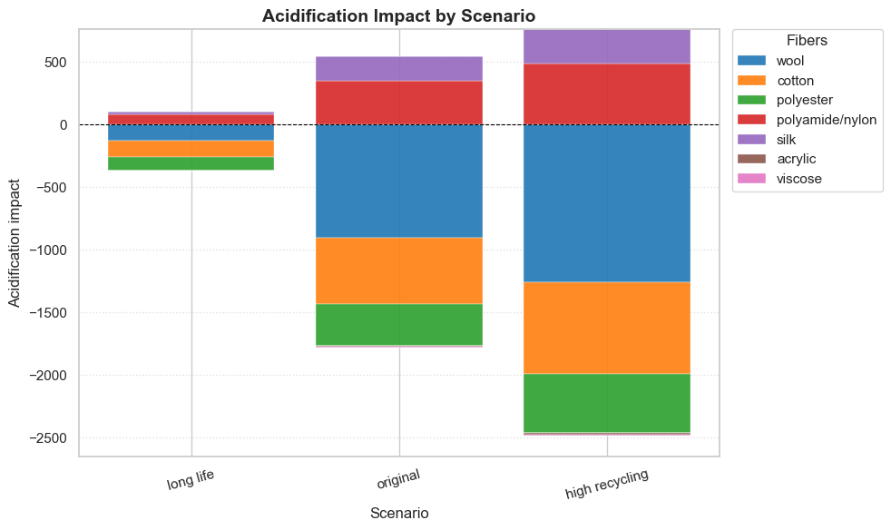
RESULTS – ACIDIFICATION IMPACT

Slide 14
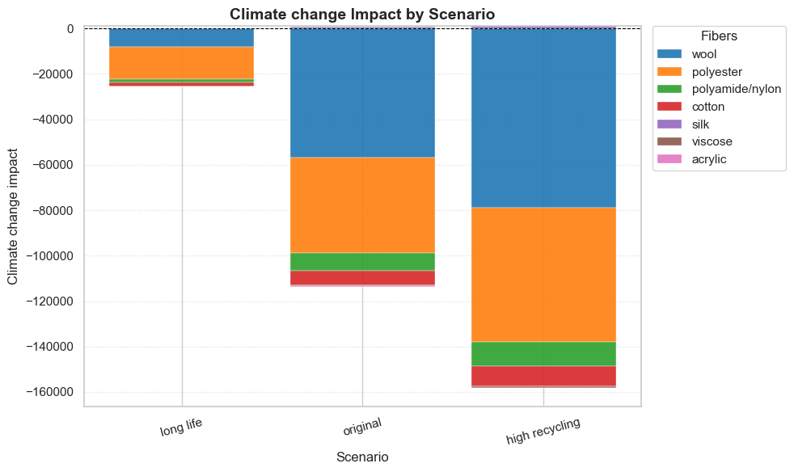
RESULTS – CLIMATE CHANGE IMPACT

Slide 15
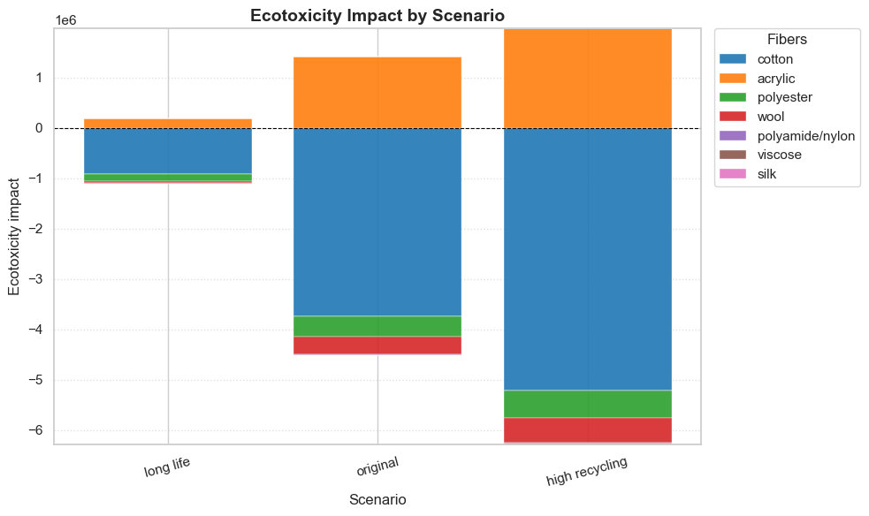
RESULTS – ECOTOXICITY IMPACT

Slide 16
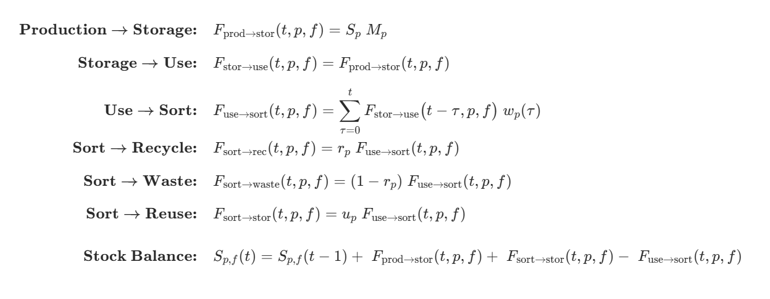
Model Equations
(At Consumer)

Slide 17
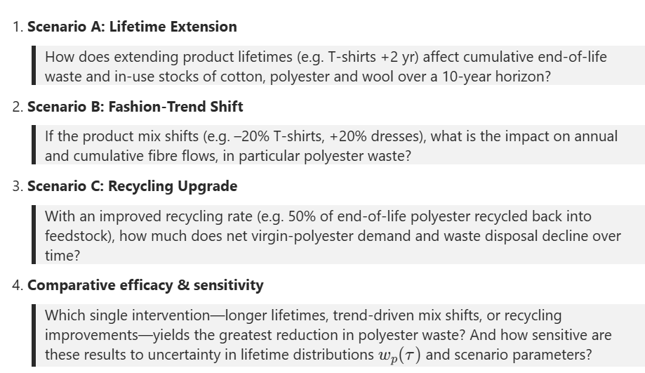
SCENARIOS

Slide 18
MFA
LCA
INCINERATION
PLANT
WASTE
Reuse
RAW MATERIALS
PRODUCTION
STORE
CONSUMER
SORT
Probabilistic Lifetime of Products
RECYCLE
RECYCLED MATERIALS

Slide 19
MFA
OUR FOCUS
Reuse
INCINERATEDWASTE
PRODUCTION
STORAGE
CONSUMER
SORT
RECYCLE
LAYERS
FIBERS
FINDINGS
SHREDDING

Slide 20
MFA
LCA
INCINERATION
PLANT
WASTE
0
3
RAW MATERIALS
PRODUCTION
STORE
CONSUMER
SORT
1
Probabilistic Lifetime of Products
4
RECYCLE
RECYCLED MATERIALS
2

Slide 21
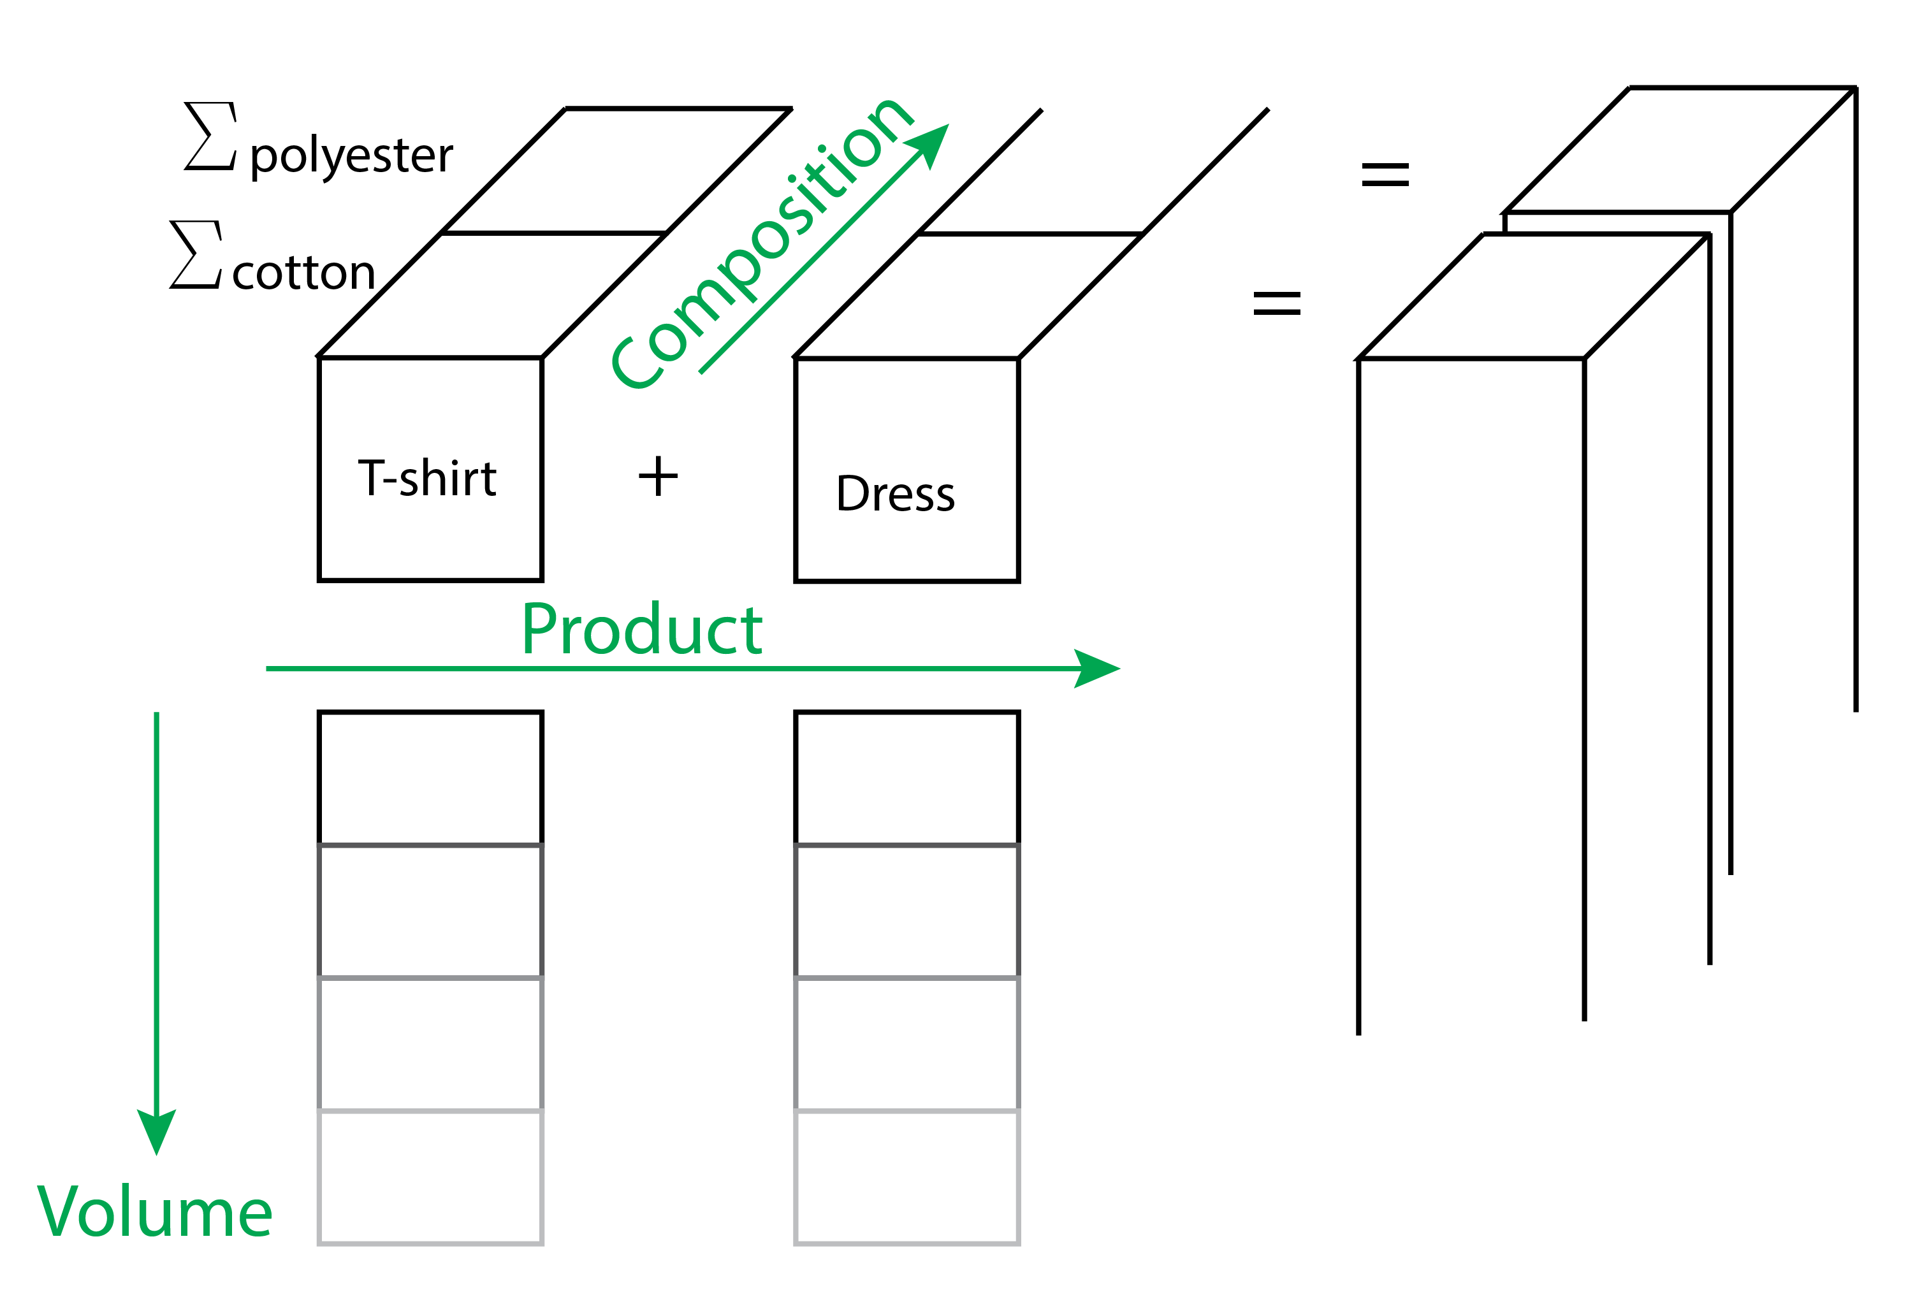
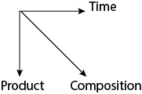
MFA DIMENSIONS
Categories

